Slide 1

QuizKtc - A Proctoring based Quiz Taking Web Application exclusively for AIKTC
QuizKtc tackles academic dishonesty in online quizzes. It uses advanced proctoring and gamification.
AS

Slide 2
QuizKTC
A Proctoring based Web Application exclusively for AIKTC students.
QuizKtc – Advanced Online Quiz Platform with Proctoring
Students :
Kalsekar Abdul Rehman Abdul Alim 23EC23
Shaikh Mohd Arsan Abdul Sattar 23EC59
Ansari Mohd Adnan Mohd Ali 23EC14
Shaikh Mohammed Affan Mohammed Umar 23EC57
Mentor ::
Prof. Ganansekaran
Institution
A.I. Kalsekar Technical Campus, New Panvel

Slide 3

Introduction
1
Our Aim
2
Motivation
QuizKTC aims to provide an interactive platform for AIKTC Studnets
To improve Quiz taking experience and assessment, here at AIKTC & build an in house Quiz management Software
3
Objectives
Create a scalable, customizable quiz platform with real-time analytics and diverse quiz type for AIKTC students & faculties.

Slide 4
Literature Survey
Existing Platforms
Limitations
Google Forms, Kahoot lack robust proctoring.
Absence of effective anti-cheating measures.
Limited security features.
Insufficient analytics.
Simple question types.
Poor user engagement.
Simple question types.

Slide 5
Limitations of Existing Systems
As discussed earlier, the only solution used by AIKTC Faculties is Google Form and Kahoot, However, it possess some proctoring issues which we aim to solve :
A single user can attempt a quiz multiple times on Kahoot
Students often google the answer and hence accurate results are not delivered.
Students often copy and paste the question in ChatGPT and complete these quizzes.
Due to these issues the segregation of Low/Advance Learners is disturbed.

Slide 6

Problem Statement
Problem: Currently the quiz platforms used by AIKTC Students and Faculties fail to implement certain proctoring features which are discussed earlier.
We have created a Quiz Website QUIZKTC which offers the required Proctoring features discussed earlier i.e.
Complete User Management
Single User can Attempt a Quiz Only Once
Camera Access of the User is required
User cannot switch applications
User cannot switch the tabs (if tab switches are more than 3, quiz automatically gets submitted)
Right click is Disabled
User cannot copy content from the webpage etc

Slide 7
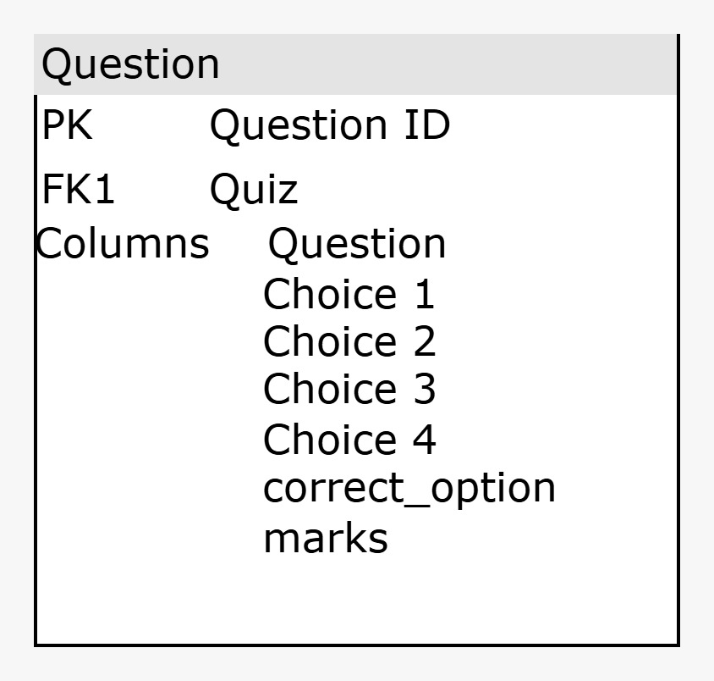
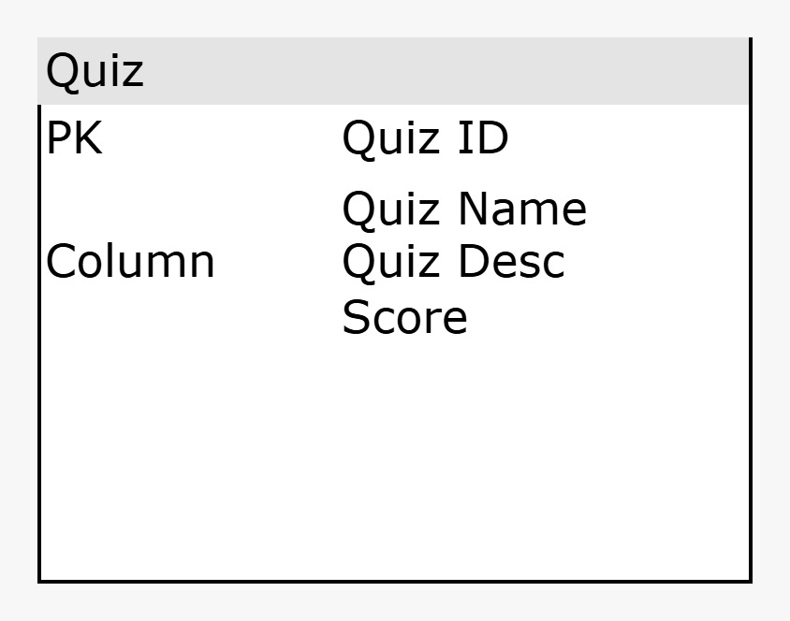


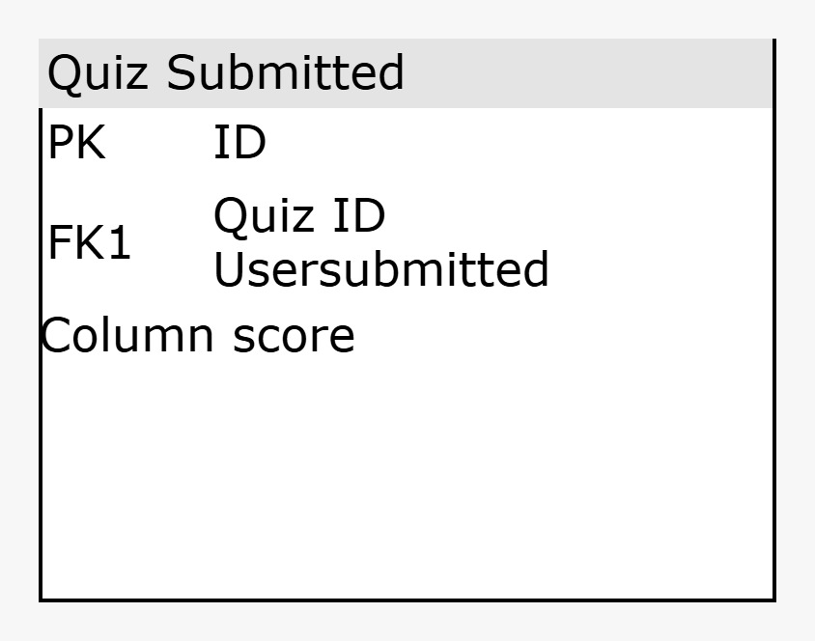
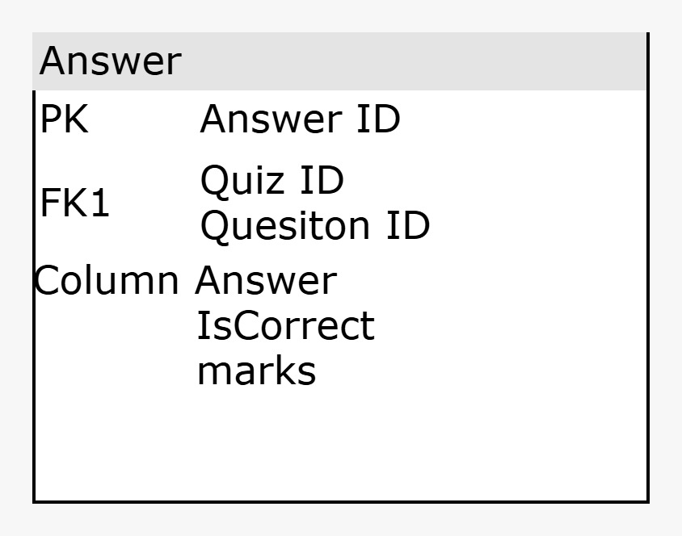


System Design and Architecture
Student Login
Secure login for students.
Quiz Attempt
Students take quizzes under proctoring.
Results
Students get results and feedback.
Teacher Dashboard
Teachers create quizzes and access analytics.

Slide 8
Proposed Methodology/Techniques
1
Frontend
Frontend has been created using a HTML, CSS and Boostrap.
2
Backend
Backend has been Created using a Python, Django
Proctoring
3
Proctoring features are mainly implemented using Javascript and its Libraries
4
Database
Sqlite3 has been used as SQL based database

Slide 9
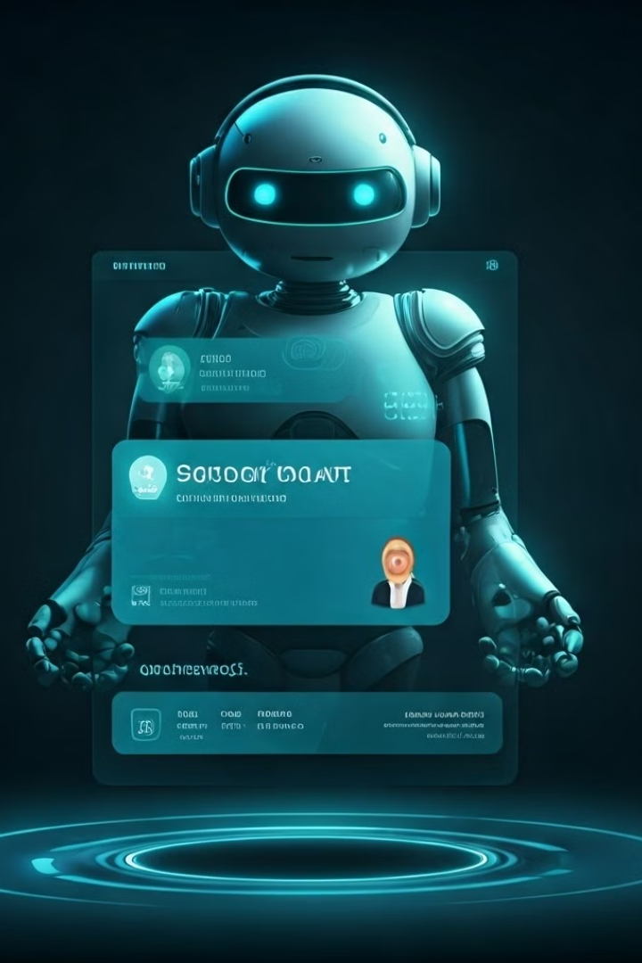



Future Enhancements
AI Feedback
AI-powered feedback based on performance.
Advanced Analytics
More detailed class performance analysis.
Enhanced Security
Improved proctoring techniques for better security.

Slide 10

Implementation Details
Languages
Technologies
Python (Django), JavaScript, HTML, CSS (Bootstrap).
Django, PostgreSQL, Bootstrap, Chart.js.
Tools
Hosting
Visual Studio Code, Git ,
Github.
Deployed on AWS with
Continues integration [CI/CO]
Pipeline

Slide 11

Key Features of QuizKtc
1
Tab Detection
2
Auto Submit
Prevents switching tabs during quizzes.
On switching Tab more than 3 times quiz get auto submit.
3
AI Feedback (Future)
4
Right Click Disable
Personalized feedback post-quiz.
Student can’t copy or paste answers our stuff like thus .

Slide 12
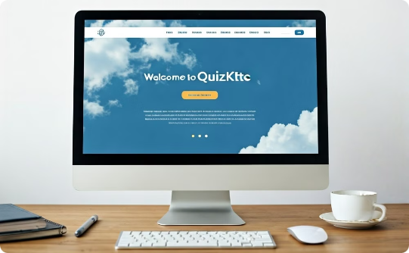
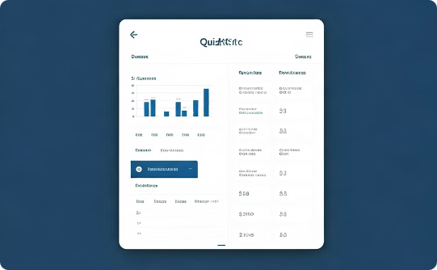

Result Analysis: Screenshots
Landing Page
Student Dashboard
Teacher Dashboard
User-friendly registration.
Clear progress tracking.
Comprehensive analytics.

Slide 13
Result Analysis: Screenshots
Landing Page
Student Dashboard
Teacher Dashboard
User-friendly registration.
Clear progress tracking.
Comprehensive analytics.

Slide 14
Result Analysis
Following is a result of our plate form
Admins can create Quizzes and Students can Complete the Quizzes.
Complete User Management.
Single User can Attempt a Quiz Only Once.
Camera Access of the User is required.
User cannot switch applications.
User cannot switch the tabs (if tab switches are more than 3, quiz automatically gets submitted).
Right click is Disabled.
User cannot copy content from the webpage etc.

Slide 15
Conclusion: Success and Future
Success
Engagement
Future
QuizKtc effectively combats cheating. It uses proctoring and gamification.
Gamified learning enhances student participation.
AI chatbot integration and real-time leaderboards.

Slide 16




Future Work: Expanding QuizKtc
AI Feedback
Personalized improvement suggestions.
Monthly Reports
Detailed teacher performance reports.
Real-time Leaderboard
Live updates for student rankings.

Slide 17
References
All resources used for development are listed. These include websites, articles, and research papers.
Official React.js Documentation: https://reactjs.org/docs/getting-started.html
Node.js Documentation: https://nodejs.org/en/docs/
MongoDB Documentation: https://docs.mongodb.com/
AWS Official Guide: https://aws.amazon.com/documentation/
SQLite3 Database

